Slide 1
Minimum Spanning Tree
(Prim’s Algorithm)

Slide 2
Problem: Laying Telephone Wire
Central office

Slide 3
Wiring: Naïve Approach
Central office
Expensive!

Slide 4
Wiring: Better Approach
Central office
Minimize the total length of wire connecting the customers

Slide 5
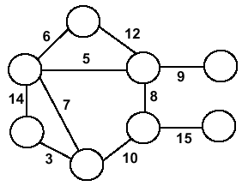
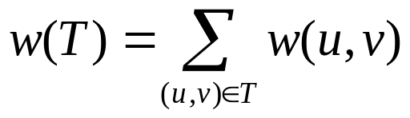
Minimum Spanning Trees
Undirected, connected graph G = (V,E)
Weight function W: E → R (assigning cost or length or other values to edges)
Spanning tree: tree that connects all the vertices (above?)
Minimum spanning tree: tree that connects all the vertices and minimizes

Slide 6
Minimum Spanning Tree (MST)
A minimum spanning tree is a subgraph of an undirected weighted graph G, such that
it is a tree (i.e., it is acyclic)
it covers all the vertices V
  contains |V| - 1 edges
the total cost associated with tree edges is the minimum among all possible spanning trees
not necessarily unique

Slide 7
How Can We Generate a MST?
9
b
9
b
a
2
6
a
2
6
d
d
4
5
4
5
5
4
5
4
5
e
5
e
c
c

Slide 8
MST Algorithms
We will show two ways to build a minimum spanning tree.
A MST can be grown from the current spanning tree by adding the nearest vertex and the edge connecting the nearest vertex to the MST. (Prim's algorithm)
A MST can be grown from a forest of spanning trees by adding the smallest edge connecting two spanning trees. (Kruskal's algorithm)

Slide 9
Notation
Tree-vertices: in the tree constructed so far
Non-tree vertices: rest of vertices
Prim’s Selection rule
Select the minimum weight edge between a tree-node and a non-tree node and add to the tree

Slide 10
The Prim algorithm Main Idea
Select a vertex to be a tree-node
while (there are non-tree vertices) {
if there is no edge connecting a tree node with a non-tree node
return “no spanning tree”
select an edge of minimum weight between a tree node and a non-tree node
add the selected edge and its new vertex to the tree
}
return tree
6
a
4
b
5
u
14
2
10
c
v
3
8
15
d
f

Slide 11
Prim’s Algorithm
This algorith was discovered by Vojtech Jarnik in 1936 and later rediscovered by Rovert Prim.
So it is called Jarnik-Prim’s Algorithm or Prim’s Algorithm.
Vertex based algorithm
Grows one tree T, one vertex at a time

Slide 12
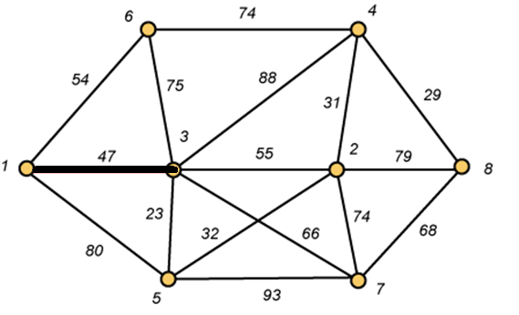
Prim – Start

Slide 13
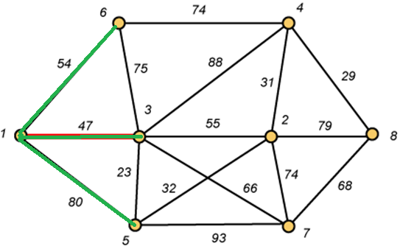
Prim – Step 1

Slide 14
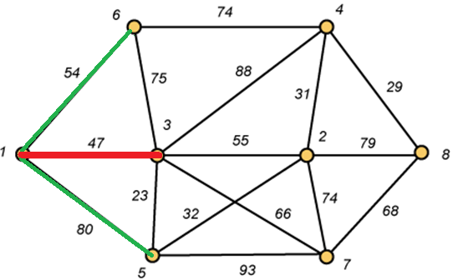
Prim – Step 1(Cont.)

Slide 15
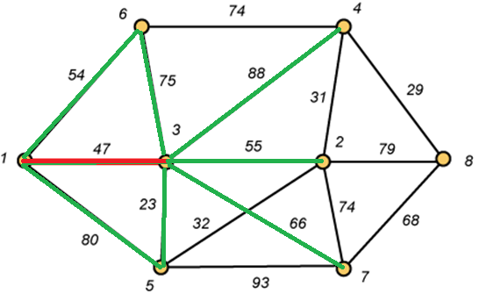
Prim – Step 2

Slide 16
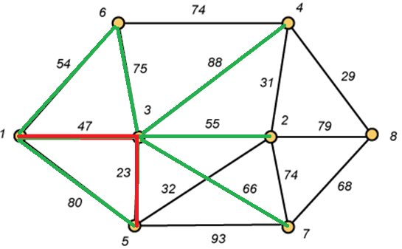
Prim – Step 2(Cont.)

Slide 17
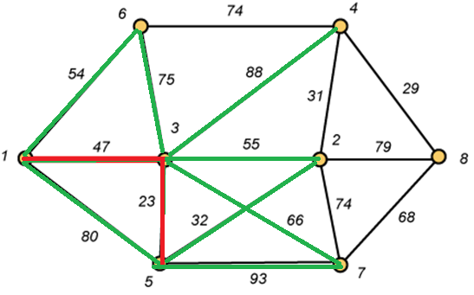
Prim – Step 3

Slide 18
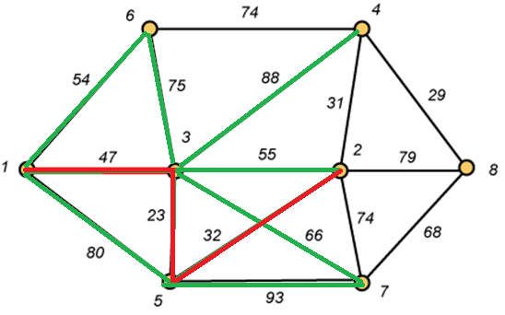
Prim – Step 3 (Cont.)

Slide 19
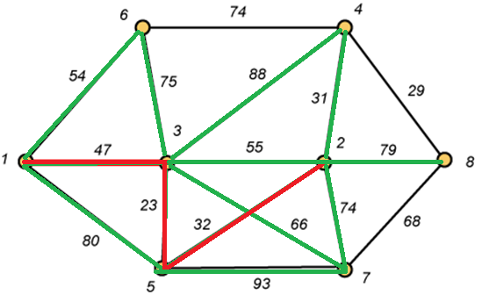
Prim – Step 4

Slide 20
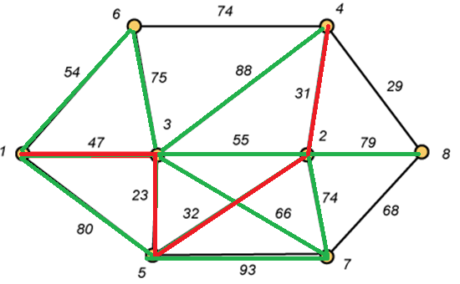
Prim – Step 4 (Cont.)

Slide 21
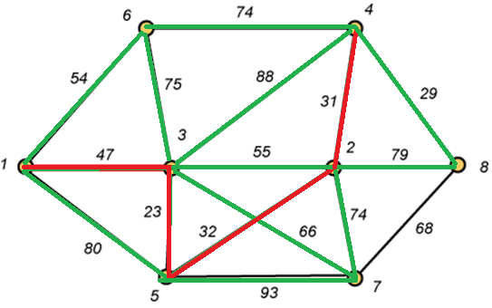
Prim – Step 5

Slide 22
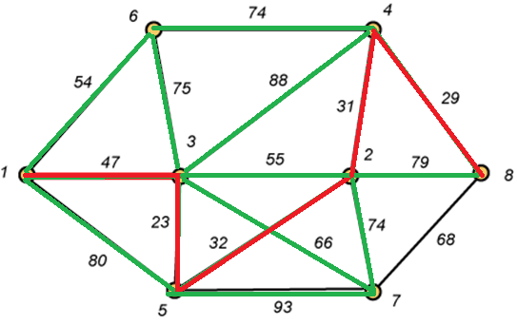
Prim – Step 5 (Cont.)

Slide 23
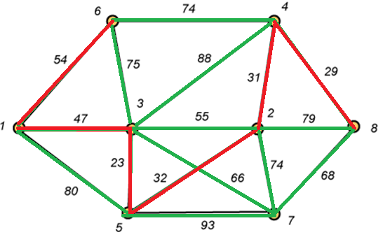
Prim – Step 6

Slide 24
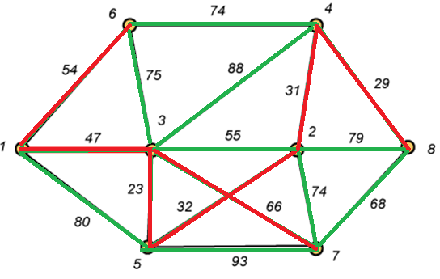
Prim – Step 7

Slide 25
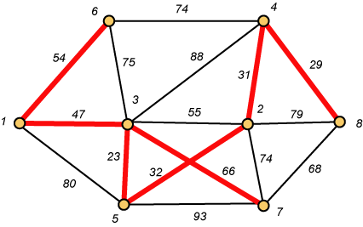
Prim – Finally Done!!
Weight (T) = 23 + 29 + 31 + 32 + 47 + 54 + 66 = 282
Minimum Spanning Cost= 282

Slide 26
Prim Algorithm (2)
MST-Prim(G,w,r)
01 Q ← V[G] // Q – vertices out of T
02 for each u ∈ Q
03 key[u] ← ∞
04 key[r] ← 0 // r is the first tree node, let r=1
05 π[r] ← NIL
06 while Q ≠ ∅ do
07 u ← ExtractMin(Q) // making u part of T
08 for each v ∈ Adj[u] do
09 if v ∈ Q and w(u,v) < key[v] then
10 π[v] ← u
11 key[v] ← w(u,v)

Slide 27
Prim Algorithm:Variables
r:
  Grow the minimum spanning tree from the root vertex “r”.
Q:
  is a priority queue, holding all vertices that are not in the tree now.
key[v]:
  is the minimum weight of any edge connecting v to a vertex in the tree.
π [v]:
  names the parent of v in the tree.
T[v] –
  Vertex v is already included in MST if T[v]==1, otherwise, it is not included yet.

Slide 28
The execution of Prim's algorithm(moderate part)
8
7
the root vertex
b
c
d
9
4
2
a
11
i
14
e
4
7
6
8
10
h
g
f
1
2
V | a | b | c | d | e | f | g | h | i
T | 1 | 0 | 0 | 0 | 0 | 0 | 0 | 0 | 0
Key | 0 | - | - | - | - | - | - | - | -
π | -1 | - | - | - | - | - | - | - | -

Slide 29
The execution of Prim's algorithm(moderate part)
8
7
the root vertex
b
c
d
9
4
2
a
11
i
14
e
4
7
6
8
10
h
g
f
1
2
V | a | b | c | d | e | f | g | h | i
T | 1 | 0 | 0 | 0 | 0 | 0 | 0 | 0 | 0
Key | 0 | 4 | - | - | - | - | - | 8 | -
π | -1 | a | - | - | - | - | - | a | -

Slide 30
The execution of Prim's algorithm(moderate part)
8
7
the root vertex
b
c
d
9
4
2
a
11
i
14
e
4
7
6
8
10
h
g
f
1
2
Important: Update Key[v] only if T[v]==0
V | a | b | c | d | e | f | g | h | i
T | 1 | 1 | 0 | 0 | 0 | 0 | 0 | 0 | 0
Key | 0 | 4 | 8 | - | - | - | - | 8 | -
π | -1 | a | b | - | - | - | - | a | -

Slide 31
The execution of Prim's algorithm(moderate part)
8
7
the root vertex
b
c
d
9
4
2
a
11
i
14
e
4
7
6
8
10
h
g
f
1
2
V | a | b | c | d | e | f | g | h | i
T | 1 | 1 | 1 | 0 | 0 | 0 | 0 | 0 | 0
Key | 0 | 4 | 8 | 7 | - | 4 | - | 8 | 2
π | -1 | a | b | c | - | c | - | a | c

Slide 32
The execution of Prim's algorithm(moderate part)
8
7
the root vertex
b
c
d
9
4
2
a
11
i
14
e
4
7
6
8
10
h
g
f
1
2
V | a | b | c | d | e | f | g | h | i
T | 1 | 1 | 1 | 0 | 0 | 0 | 0 | 0 | 1
Key | 0 | 4 | 8 | 7 | - | 4 | 6 | 7 | 2
π | -1 | a | b | c | - | c | i | i | c

Slide 33
The execution of Prim's algorithm(moderate part)
8
7
the root vertex
b
c
d
9
4
2
a
11
i
14
e
4
7
6
8
10
h
g
f
1
2
V | a | b | c | d | e | f | g | h | i
T | 1 | 1 | 1 | 0 | 0 | 1 | 0 | 0 | 1
Key | 0 | 4 | 8 | 7 | 10 | 4 | 2 | 7 | 2
π | -1 | a | b | c | f | c | f | i | c

Slide 34
The execution of Prim's algorithm(moderate part)
8
7
the root vertex
b
c
d
9
4
2
a
11
i
14
e
4
7
6
8
10
h
g
f
1
2
V | a | b | c | d | e | f | g | h | i
T | 1 | 1 | 1 | 0 | 0 | 1 | 1 | 0 | 1
Key | 0 | 4 | 8 | 7 | 10 | 4 | 2 | 1 | 2
π | -1 | a | b | c | f | c | f | g | c

Slide 35
The execution of Prim's algorithm(moderate part)
8
7
the root vertex
b
c
d
9
4
2
a
11
i
14
e
4
7
6
8
10
h
g
f
1
2
V | a | b | c | d | e | f | g | h | i
T | 1 | 1 | 1 | 0 | 0 | 1 | 1 | 1 | 1
Key | 0 | 4 | 8 | 7 | 10 | 4 | 2 | 1 | 2
π | -1 | a | b | c | f | c | f | g | c

Slide 36
The execution of Prim's algorithm(moderate part)
8
7
the root vertex
b
c
d
9
4
2
a
11
i
14
e
4
7
6
8
10
h
g
f
1
2
V | a | b | c | d | e | f | g | h | i
T | 1 | 1 | 1 | 1 | 0 | 1 | 1 | 1 | 1
Key | 0 | 4 | 8 | 7 | 9 | 4 | 2 | 1 | 2
π | -1 | a | b | c | d | c | f | g | c

Slide 37
The execution of Prim's algorithm(moderate part)
8
7
the root vertex
b
c
d
9
4
2
a
11
i
14
e
4
7
6
8
10
h
g
f
1
2
V | a | b | c | d | e | f | g | h | i
T | 1 | 1 | 1 | 1 | 1 | 1 | 1 | 1 | 1
Key | 0 | 4 | 8 | 7 | 9 | 4 | 2 | 1 | 2
π | -1 | a | b | c | d | c | f | g | c

Slide 38
The execution of Prim's algorithm(moderate part)
8
7
the root vertex
b
c
d
9
4
2
a
11
i
14
e
4
7
6
8
10
h
g
f
1
2
V | a | b | c | d | e | f | g | h | i
T | 1 | 1 | 1 | 1 | 1 | 1 | 1 | 1 | 1
Key | 0 | 4 | 8 | 7 | 9 | 4 | 2 | 1 | 2
π | -1 | a | b | c | d | c | f | g | c
Minimum Spanning Cost = 4+8+7+9+4+2+1+2=37

Slide 39
Complexity: Prim Algorithm
MST-Prim(G,w,r)
01 Q ← V[G] // Q – vertices out of T
02 for each u ∈ Q
03 key[u] ← ∞
04 key[r] ← 0
05 π[r] ← NIL
06 while Q ≠ ∅ do
07 u ← ExtractMin(Q) // making u part of T
08 for each v ∈ Adj[u] do
09 if v ∈ Q and w(u,v) < key[v] then
10 π[v] ← u
11 key[v] ← w(u,v)
O(V)
O(V)
Heap: O(lgV)
Overall: O(E)
Decrease Key: O(lgV)
Overall complexity: O(V)+O(V lg V+E lg V) = O(E lg V)

Slide 40
Overall Complexity Analysis
O(V²)
  When we don’t use heap
  To find the minimum element, we traverse the “KEY” array from beginning to end
  We use adjacency matrix to update KEY.
O(ElogV)
  When min-heap is used to find the minimum element from “KEY”.
O(E+VlogV)
  When fibonacci heap is used to find the minimum element from “KEY”.

